Slide 1
FRAUD DETECTION

Slide 2
Team Ali Mohamed Mokhtar Alrafei Omar Farouk Abdelwahed Ibrahim Ahmed Mohamed Ahmed Talha Loay Yazed Peter Magdy Gamil
Tech Company: AST
Notes:
`

Slide 3
Team roles
Dataset Collection
Data Exploration
Data Preprocessing
Model Training
Web app
Model Evaluation
ALL Team
Kaggle dataset
Ahmed Mokhtar
Ahmed Mokhtar
Maintenance
and Updating
Machine learning life cycle
Deployment
Ali Alrafei
Omar Farouk
Talha Loay
Peter Magdy
Ali Alrafei
Ahmed Mokhtar
Omar Farouk

Slide 4
Table of contents
1
2
03
04
05
Introduction
Dataset
Data Exploration
And visualization
Web app
Deployment

Slide 5
01
Introduction

Slide 6

Introduction
Credit Card
Serve Large Scale
Security
Easy to use

Slide 7

Credit Card Fruad

Slide 8
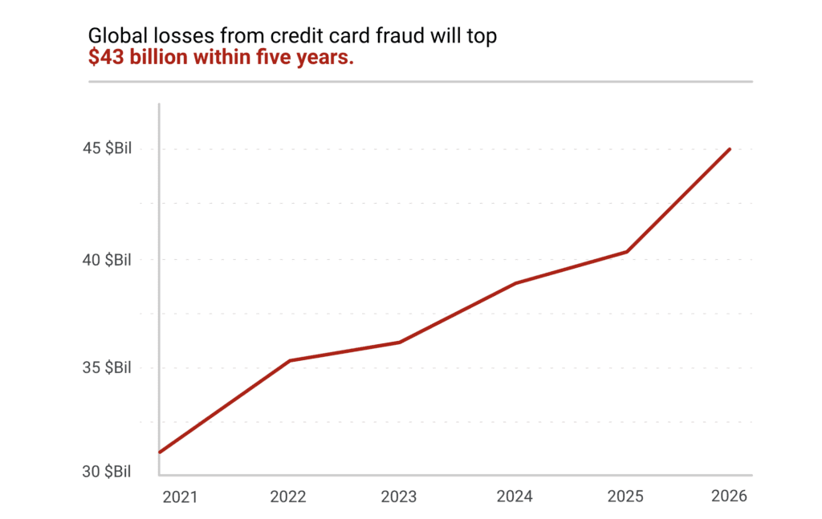

Slide 9
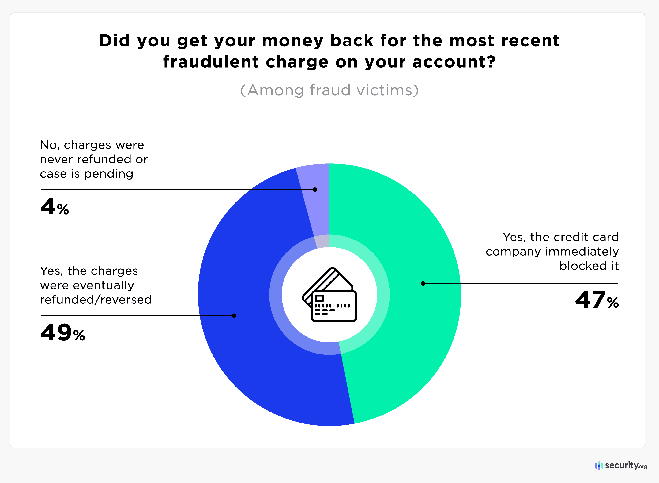

Slide 10
02
Dataset

Slide 11

Fraud Detection Dataset 2023
Dataset contains 568,630 records
30 columns
data has been anonymized to protect the cardholders' identities
Dataset URL: Credit Card Fraud Detection Dataset 2023 (kaggle.com)

Slide 12
03
Data Exploration and Visualization

Slide 13
Data Exploration
Key Features:
id: Unique identifier for each transaction
V1-V28: Anonymized features representing various transaction attributes (e.g., time, location, etc.), also the Stan
Amount: The transaction amount
Class: Binary label indicating whether the transaction is fraudulent (1) or not (0)

Slide 14
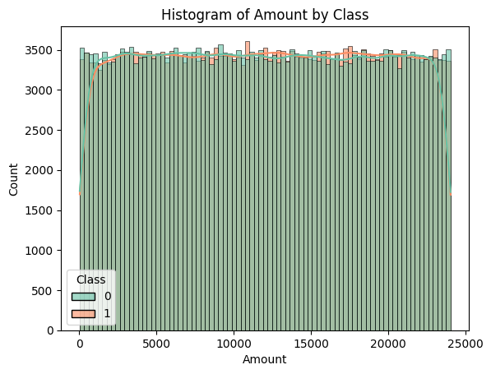
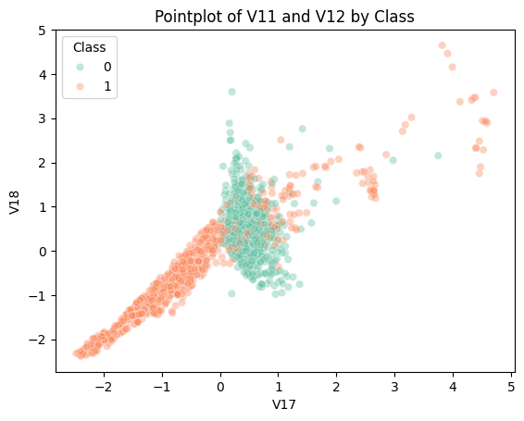
Data Visualization

Slide 15
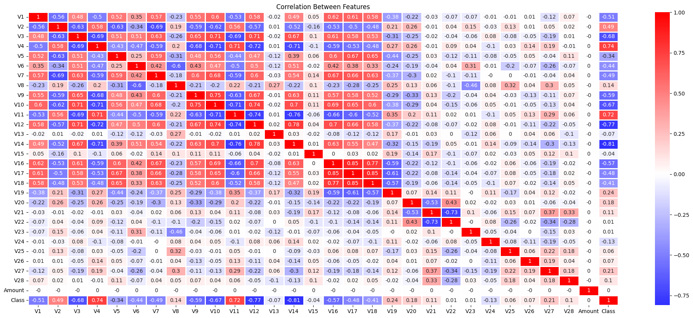
Correlation
Key Features:
1

Slide 16
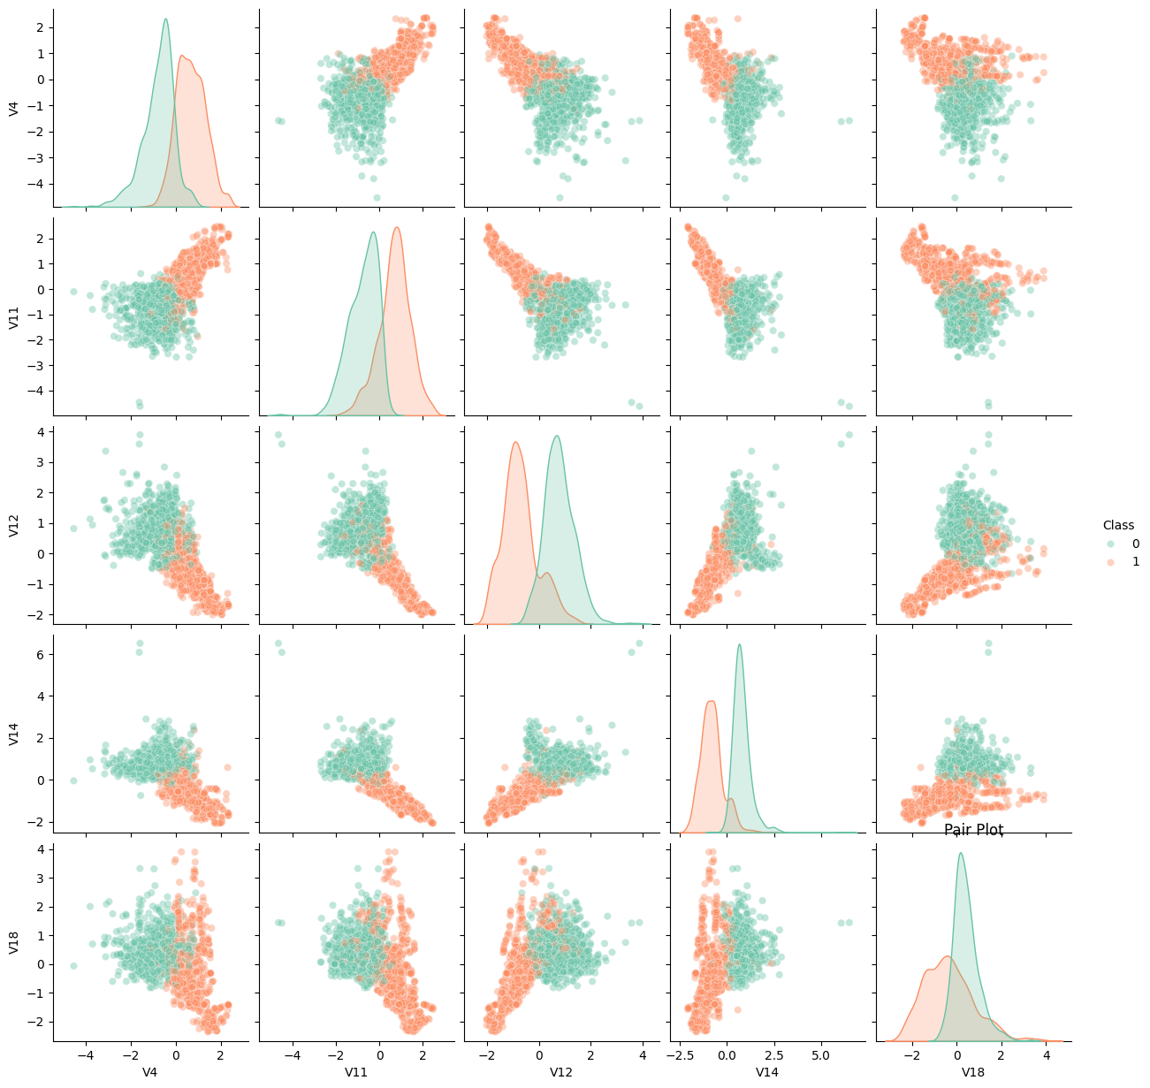
Data Visualization

Slide 17
04
Evaluation

Slide 18
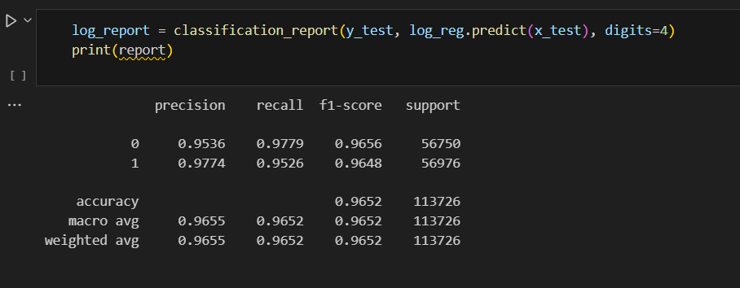
Evaluate the model

Slide 19
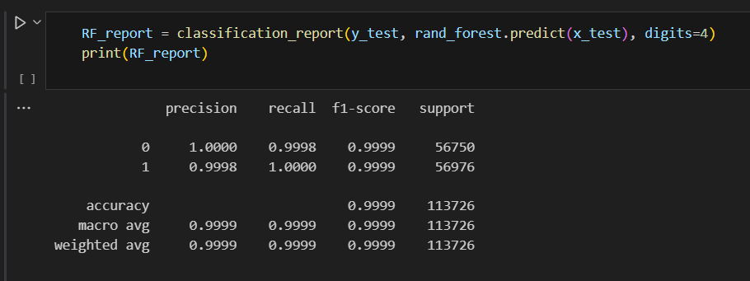
Evaluate the model

Slide 20
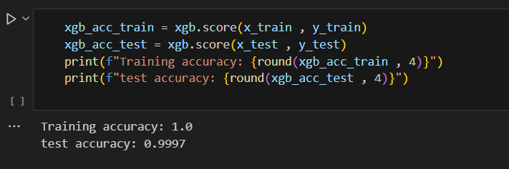
Evaluate the model

Slide 21
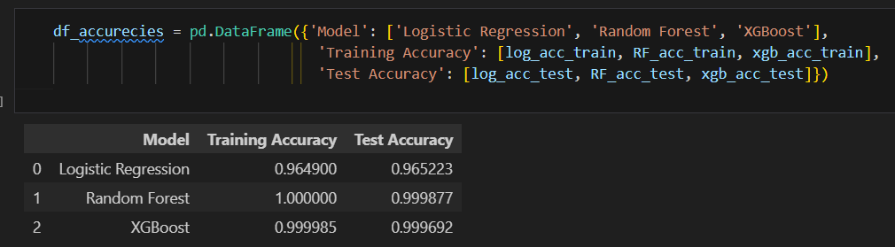
Evaluate the model

Slide 22
04
Web app

Slide 23

webapp
Web app two parts
Frontend using HTML
Backend using Flask (farmwork in python)

Slide 24
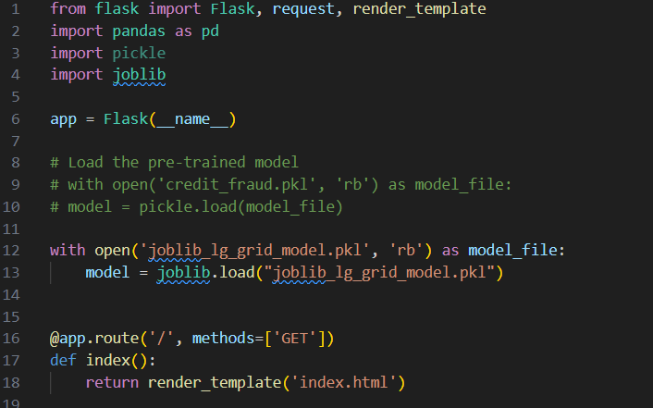
Backend
Flask

Slide 25
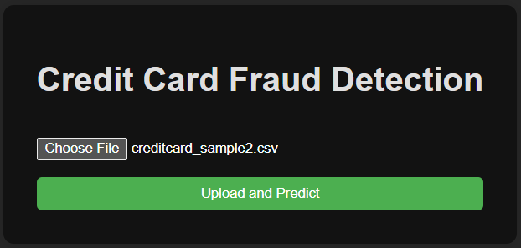
Frontend
Upload Page

Slide 26
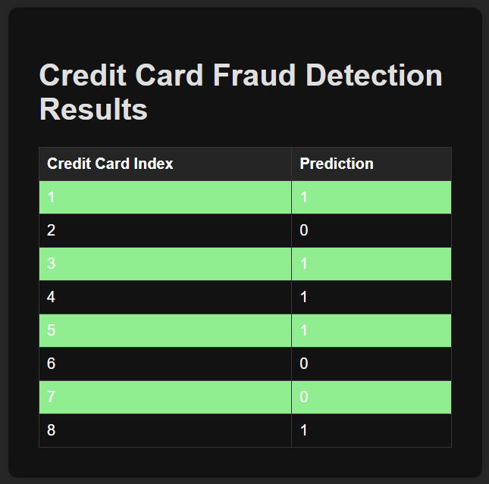
Frontend
Prediction Page

Slide 27
05
Deployment

Slide 28
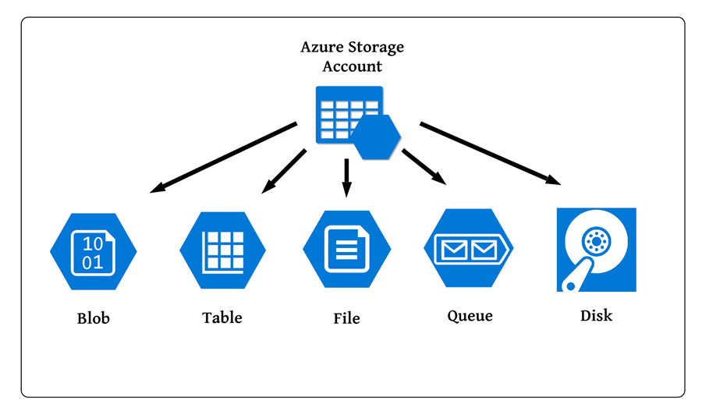
Azure Storage Account

Slide 29
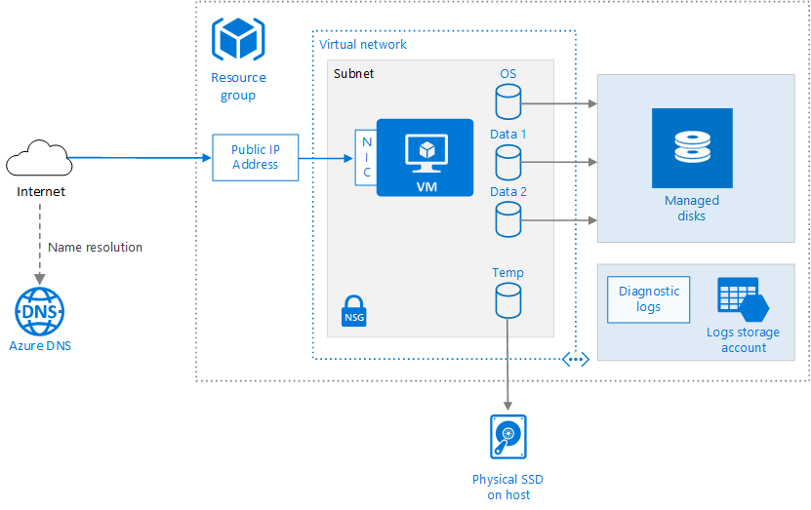
Azure VM

Slide 30
Deployment
Nginx:
is a web server that can also be used as a reverse proxy, load balancer, mail proxy and HTTP cache
Open source web server and a reverse proxy server
Gunicorn:
is a Python Web Server Gateway Interface HTTP server

Slide 31
Deployment
URL:
http://frauddetect.westus.cloudapp.azure.com

Slide 32
Thank You!

